Slide 1
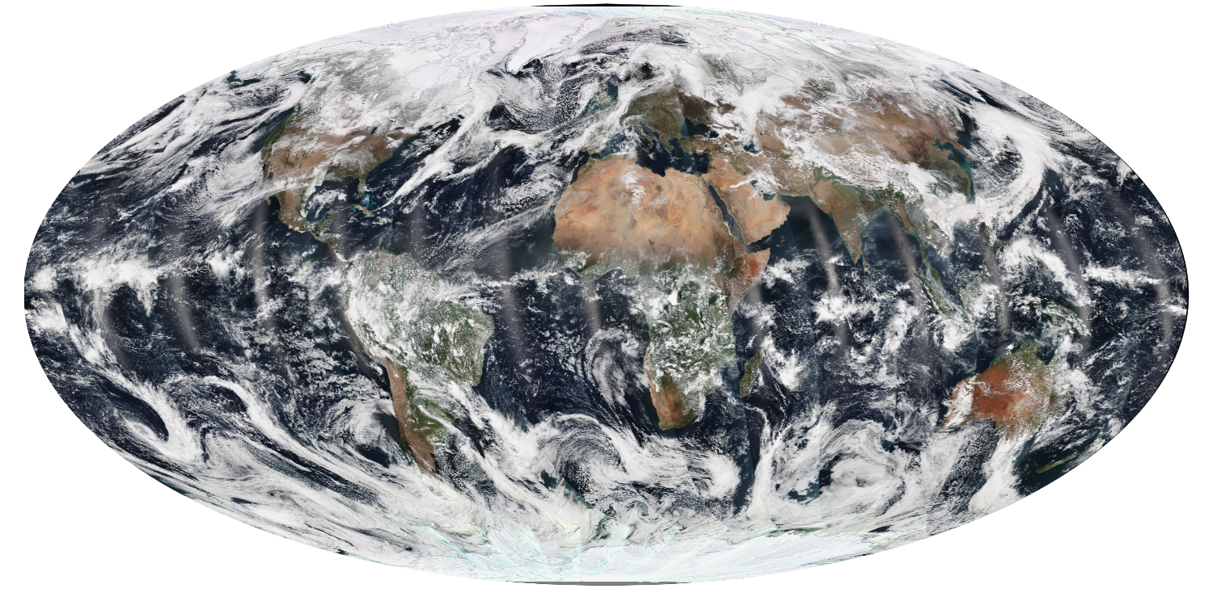

Suomi NPP Atmosphere SIPS
Liam Gumley, PI
Bob Holz and Steve Ackerman, Co-Is
VIIRS True Color 2014/03/21
Space Science and Engineering Center
University of Wisconsin-Madison

Slide 2
What is a SIPS?
Science Investigator-led Processing Systems (SIPS) create NASA science data products using algorithms and software developed by the Suomi NPP Science Team, and deliver the products to a NASA DAAC for archive and distribution.
Five SIPS were awarded in August 2014:
Atmosphere SIPS: UW-SSEC / Liam Gumley
Land SIPS: GSFC / Ed Masuoka
Ocean SIPS: GSFC / Gene Feldman
Ozone SIPS: GSFC / Ed Masuoka
Sounder SIPS: JPL / Steve Friedman
Notes:
The SIPS are a continuation of the PEATEs established by NASA. With the SIPS, we are moving from product evaluation and alternative algorithm testing to climate data record production (to continue the NASA climate record of EOS).

Slide 3
SNPP Atmosphere Discipline
1. Bryan Baum: UW-SSEC (Discipline Lead)
Continuity of Cloud Top Pressure and Cloud Infrared Thermodynamic Phase by Combining CrIS and VIIRS Measurements
2. Eva Borbas: UW-SSEC (NEW)
Continuation of EOS Clear Sky Infrared Total Precipitable Water Vapor Product Using a Combination of VIIRS and CrIMSS Measurements
3. Bo-Cai Gao: Naval Research Laboratory (NEW)
Continuation of Standard Cirrus Reflectance Product from the EOS Terra and Aqua MODIS to Suomi NPP VIIRS
4. Christopher Elvidge: NOAA-NESDIS NGDC
VIIRS Nighttime Lights
5. Christina Hsu: Goddard Space Flight Center
Extending Long-Term Aerosol Data Records from MODIS to VIIRS: Data Continuity and Enhancements to the E-Deep Blue Algorithm
6. Robert Levy: Goddard Space Flight Center
A Consistent Dark-Target Aerosol Data Record, Created from MODIS, VIIRS and Beyond
7. Steven Platnick: Goddard Space Flight Center
Development of VIIRS L2 Cloud and L3 Gridded Atmosphere Team Products for NASA Research and EOS Data Record Continuity
8. Jun Wang: University of Nebraska - Lincoln
Evaluate and Enhance Suomi NPP Products for Air Quality and Public Health Applications
Notes:
Three cloud investigations, three aerosol investigations, and one water vapor investigation. Bo-Cai Gao and Eva Borbas are new team members (both were members of the MODIS Science Team).

Slide 4
SIPS Responsibilities (from AO)
Atmosphere SIPS will:
Be responsible for processing, reprocessing, and general assessment of Suomi NPP VIIRS Atmosphere products.
Process Level 0 data to Level 1, Level 2, and global gridded Level 3 atmosphere products using scientific algorithm software from the Suomi NPP Atmosphere Discipline Group.
Deliver all data products along with scientific algorithm software, associated metadata, and documentation to a NASA-assigned DAAC.
Acquire near-real-time algorithms for selected products and process and deliver these products within three hours for distribution through the LANCE system.

Slide 5
SIPS Tasks (from SSEC proposal)
The Atmosphere SIPS will:
Assist the SNPP Science Team with integrating and testing the product generation software in the SIPS environment
Implement the product generation software in SIPS operations
Create VIIRS Level 1B data in global forward stream mode
Create VIIRS Level 2 and 3 atmosphere products in global forward stream mode (“near real-time” in 3 hours and “best product” in 48 hours)
Reprocess historical VIIRS atmosphere products when directed by the SNPP Science Team,
Provide assessment capabilities for VIIRS atmosphere products,
Deliver VIIRS atmosphere products, software, browse imagery, and associated ancillary data and metadata to NASA LAADS for archive and distribution.
Notes:
The Atmosphere SIPS builds on the resources, experience, and tools developed for the Atmosphere PEATE. The same management team and technical teams are in place. Philosophy will be very similar to the PEATE, with the biggest change being that the SIPS is responsible for global processing of products for NASA. Note that products created by the Atmosphere SIPS will go to the GSFC LAADS for archive and distribution (like the MODIS Atmosphere products). However the Atmosphere PEATE will continue to make L0, L1B, L2, and L3 products available to collaborators.

Slide 6
VIIRS Level 0 and 1B Products
VIIRS stored mission data will be delivered to the Atmosphere SIPS by NASA EDOS (via MODAPS) in a NASA-defined Level 0 format.
VIIRS Level 1A, geolocation, and 1B data will be created at the Atmosphere SIPS using a NASA version of geolocation and calibration algorithms and software and stored in a NASA-defined Level 1B format.
Atmosphere SIPS may use different LUTs or corrections in their version of the L1B processing.
Atmosphere SIPS will fuse Level 1B sounder with imager data (CrIS/VIIRS, AIR/MODIS) for several of the ST investigations (e.g., to provide 13 micron channels at VIIRS resolution). This will be done internally at the SIPS (not part of the NASA Level 1B software).
Notes:
NASA is moving away from the RDRs, SDRs, and EDRs created by the IDPS. NASA EDOS will be responsible for delivering Level 0 stored mission data to each of the SIPS. NASA HQ directed the VIIRS PEATES to form a team to design and create NASA software and formats for the L1B data. The team (led by the Ocean, Land, and Atmosphere PEATE and VCST leads) is already working on this effort. The Atmosphere SIPS will always create VIIRS L1B data onsite.

Slide 7
NASA Level 1 Software
NASA directed the PEATEs to come up with a plan to create a NASA version of Level 1 software and file formats for VIIRS, CrIS, ATMS, OMPS using Level 0 data supplied by EDOS.
Goal is to be independent of IDPS data, processing, and software
VIIRS Ocean, Land, and Atmosphere PEATEs and VCST are developing the VIIRS Level 1 software
Fred Patt (Ocean SIPS) is project leader. Liam Gumley is lead for Atmosphere.

Slide 8
NASA Level 1 Software Objectives
Modular, well-documented, efficient, robust portable software, owned and maintained by NASA.
Straightforward implementation of instrument calibration equations and support for calibration updates.
Data product formats developed and maintained by NASA. Level 1B and Geolocation will be the standard final products.
Level 1A data product will be generated as part of the processing stream.
Separate executables for Level 1A, Geolocation and Level 1B.
Reasonable granule length (e.g., 5 minutes as for MODIS) chosen by NASA.
Reduce number of Level 1B data files (i.e., eliminate separate files for each VIIRS band).

Slide 9
VIIRS vs. MODIS 5-min granules
Atmosphere PEATE
VIIRS M7 2012/06/03 18:45 (left) and Aqua MODIS band 2 2012/06/03 18:40 (right) in Intermediate File Format created by the Atmosphere PEATE for the SNPP Science Team.
Note that VIIRS Bowtie-Pixel restore is a downstream option at the Atmosphere SIPS.

Slide 10
VIIRS Level 2 Products
The Atmosphere SIPS will create VIIRS Level 2 products using software developed and owned by the investigators on the Science Team.
Software will be transitioned to operations using the same process that was used by the Atmosphere PEATE (build and test on a server provided by the SIPS).
Level 2 products will be created operationally in forward stream and near real-time processing modes.
Level 2 products for the duration of the SNPP mission will be reprocessed when directed by the Science Team.
Level 2 products will be created in a non-public processing mode for algorithm and software development and testing.

Slide 11
VIIRS Level 2 Product Examples
Monthly means of Aerosol Optical Depth for July 2012 from
^{MODIS Dark} ^{Target,} VIIRS Deep Blue, and VIIRS IDPS algorithms (Hsu 2013).
Christina Hsu

Slide 12
VIIRS Level 3 Products
Level 3 products will be created by the Atmosphere SIPS using algorithms and/or software created by the Science Team.
The Atmosphere SIPS may implement the software to run the Level 3 algorithms (to provide consistency across products).
The Science Team will decide how to filter and grid the Level 2 data to create Level 3 products.
Atmosphere PEATE
SNPP VIIRS CHIMERA and Aqua MODIS C6
Water Cloud Optical Thickness Level 3 products for Jan. 2014

Slide 13
Items Delivered to DAAC
Data products along with scientific algorithm software source code, coefficients, and ancillary data used to generate these products to the NASA-assigned Distributed Active Archive Center (DAAC) with no period of exclusive access.
Algorithm Theoretical Basis Document (ATBD) documentation as well as the accompanying spatial, temporal, and product metadata associated with the standard products.
Browse products associated with standard products.

Slide 14
Current ST Support Activities
Polling ST to find out what support they need in the short term (mainly new PIs)
Giving new ST members access to SIPS development, test, and data resources
Learning about ST software and product plans (coordinated by Discipline Lead B. Baum)
Continuing to support algorithm testing for continuing ST members (Baum, Platnick, Hsu, Levy)
Participating in VIIRS Level 1B Redesign
UW/SSEC and UMBC are leading CrIS Level 1B Redesign

Slide 15
Continuing PEATE Activities
Ingesting IDPS VIIRS, CrIS, and ATMS RDRs via SD3E (continue until EDOS transition is complete)
Ingesting IDPS VIIRS, CrIS, and ATMS SDRs via SD3E (will end soon)
Creating SIPS VIIRS, CrIS, and ATMS SDRs in forward stream
Creating quicklooks for Level 1, Level 2, and Level 3
Creating prototype Level 2 atmosphere products in test mode for ST
Providing IDPS and SIPS products and quicklooks to ST members and collaborators
Providing product evaluation for ST members (e.g., MODIS/VIIRS and VIIRS/CALIPSO comparisons)

Slide 16
Product Evaluation
Atmosphere PEATE
Global distribution of Cloud Top Height differences between VIIRS IDPS and CALIPSO products created by the Atmosphere PEATE for the SNPP Science Team cloud product assessment report

Slide 17
Key Archived Data
VIIRS, CrIS, and ATMS RDRs for SNPP mission
VIIRS, CrIS, and ATMS SDRs for SNPP mission (soon to be replaced by locally created SDRs, until NASA Level 1B is available)
Aqua MODIS Level 1B since 2010
AIRS Level 1B for Aqua mission
IASI Level 1B for Metop-A and Metop-B missions
CALIOP Level 1 and Level 2 for CALIPSO mission

Slide 18
Product Generation by SIPS
Atmosphere SIPS processing will be separated into four separate modes, all operating simultaneously:
Forward Stream Processing Mode: create the best possible global VIIRS L1B and Atmosphere L2/L3 products using the highest fidelity input data sources (requires 24-48 hour delay). Atmosphere L2/L3 products are delivered to LAADS.
Near Real-Time Processing Mode: create low latency global VIIRS L1B and Atmosphere L2 products (< 3 hours). Atmosphere L2 products are delivered to LANCE.
Historical Reprocessing Mode: create the best possible VIIRS L1B and Atmosphere L2/L3 products for the entire SNPP mission record (< 2 weeks to process entire mission). Atmosphere L2/L3 products are delivered to LAADS.
Experimental Reprocessing and Evaluation Mode: create global VIIRS Level 1B and Atmosphere L2/L3 test products and global collocated inter-comparison products for review and evaluation by the SNPP Science Team. Products are delivered to Science Team only.

Slide 19
SIPS Infrastructure
The Atmosphere SIPS utilizes the infrastructure built by the Atmosphere PEATE including:
> 800 CPU cores for data processing with 4 GB RAM per core (can expand to use > 8000 cores on UW campus);
> 2 PB of formatted data storage;
Private switched Gigabit Ethernet network between all processing and storage servers;
10 Gbps network interfaces from data ingest and distribution servers to the UW-Madison campus backbone, supporting sustained data ingest rates of greater than 1 Gbps;
Dedicated servers for SNPP Science Team members to develop and test algorithms;
Secure in-house data center with in-row cooling, UPS power, and routine backups.

Slide 20
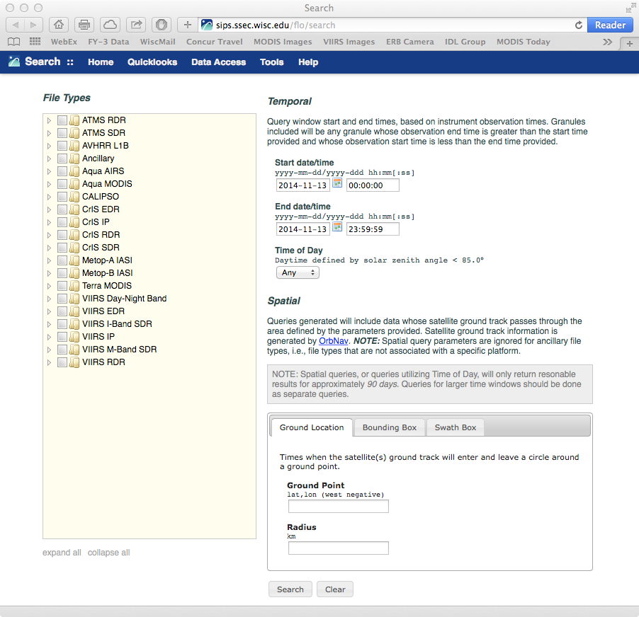
SIPS Website
SIPS website: http://sips.ssec.wisc.edu/
Data search and download (try the API!)
Browse imagery
Documentation
Orbit tools
Orbit tracks

Slide 21
END
Liam.Gumley@ssec.wisc.edu
+1 608 265 5358

